Slide 1

INHERITANCE
Amit Patel
Vidyabharti Trust College of BCA, Umrakh
Notes:
Chapter 2

Slide 2
Inheritance
Inheritance is a process in which one object acquires all the properties and behaviors of its parent object automatically.
In such way, you can reuse, extend or modify the attributes and behaviors which are defined in other class.
In C++, the class which inherits the members of another class is called derived class and the class whose members are inherited is called base class.
The derived class is the specialized class for the base class.
Chapter 18
Notes:
Chapter 2

Slide 3
Parent Class / Main Class /
Base Class
CLASS A
Child Class / Derived Class /
Sub Class
CLASS B
Chapter 18

Slide 4
Inheritance
Derived Class
The class which inherits the members of another class is called derived class
It inherit member of base class based on the access mode. Access mode can be public, private or protected.
Also Known as Child Class or Sub Class.
Contain Some or All member data of Base class.
In previous slide “Class B” is Child class.
Chapter 18
Notes:
Chapter 2

Slide 5
Inheritance
Base Class
The class whose members are inherited is called base class.
Also Known as Parent Class or Main Class.
Some or All member data are inherited to child class.
In previous slide “Class A” is Main class.
Chapter 18
Notes:
Chapter 2

Slide 6
Why Inheritance?
Consider a group of vehicles. You need to create classes for Bus, Car and Truck.
The methods fuelAmount(), capacity(), applyBrakes() will be same for all of the three classes.
If we create these classes avoiding inheritance then we have to write all of these functions in each of the three classes as shown in below figure:
Chapter 18
Notes:
Chapter 2

Slide 7
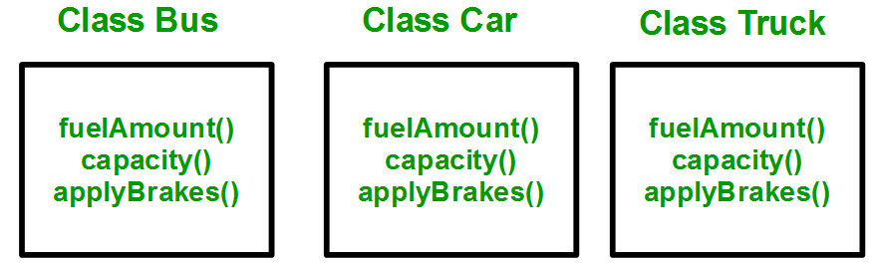
Chapter 18

Slide 8
Why Inheritance?
You can clearly see that above process results in duplication of same code 3 times.
This increases the chances of error and data redundancy. To avoid this type of situation, inheritance is used.
If we create a class Vehicle and write these three functions in it and inherit the rest of the classes from the vehicle class, then we can simply avoid the duplication of data and increase re-usability.
Look at the below diagram in which the three classes are inherited from vehicle class:
Chapter 18
Notes:
Chapter 2

Slide 9
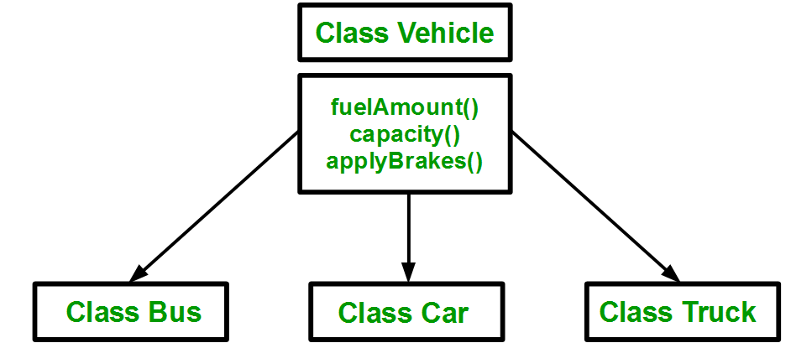
Using inheritance, we have to write the functions only one time instead of three times as we have inherited rest of the three classes from base class(Vehicle).
Chapter 18

Slide 10
Advance of Inheritance
Code reusability: You can reuse the members of your parent class. So, there is no need to define the member again. So less code is required in the class.
Easy Maintenance: Inheritance allows us to define a class in terms of another class, which makes it easier to create and maintain an application.
Chapter 18
Notes:
Chapter 2

Slide 11
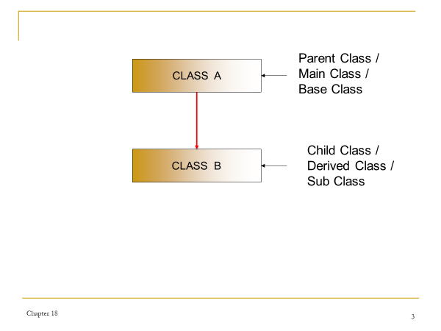
Implimentation of Inheritance
For creating a sub-class which is inherited from the base class we have to follow the below syntax.
Syntax of subclass :
  class <subclass_name> : <access_mode> <base_class_name>
  {
  //body of subclass
  };
Chapter 18
Notes:
Chapter 2

Slide 12
Implementation of Inheritance
Here, subclass_name is the name of the sub class.
<access_mode> is the mode in which you want to inherit this sub class for example: public, private or protected.
<base_class_name> is the name of the base class from which you want to inherit the sub class.
A derived class doesn’t inherit to private data members.
Chapter 18
Notes:
Chapter 2

Slide 13
Implementation of Inheritance
Here, subclass_name is the name of the sub class.
<access_mode> is the mode in which you want to inherit this sub class for example: public, private or protected.
<base_class_name> is the name of the base class from which you want to inherit the sub class.
All data of base class except private data can be inherited to subclass.
A derived class doesn’t inherit to private data members.
Based on <access mode> , base class data is inherited to subclass.
Chapter 18
Notes:
Chapter 2

Slide 14
Implimentation of Inheritance
  class student
  {
  int id; char name[30];
  public:
  void getdata();
  void putdata();
  };
  class address : private student
  {
  char village[30],city[30],pincode[7];
  public:
  void input();
  void output();
  };
Chapter 18
Notes:
Chapter 2

Slide 15
Access mode and Inheritance
Access mode is also known as Access Specifier or Visibility Mode.
A derived class can access all the non-private members of its base class.
Access mode can be private , public or protected.
We can summarize the different access types according to - who can access them in the following way
Chapter 18
Notes:
Chapter 2

Slide 16
Access mode and Inheritance
Access | public | protected | private
Same class | yes | yes | yes
Derived classes | yes | yes | no
Outside classes | yes | no | no
Chapter 18
Notes:
Chapter 2

Slide 17
Access mode and Inheritance
Base class visibility | Derived class visibility
 | Public | Private | Protected
Private | Not Inherited | Not Inherited | Not Inherited
Protected | Protected | Private | Protected
Public | Public | Private | Protected
Chapter 18
Notes:
Chapter 2

Slide 18
Access mode and Inheritance
Public mode: If we derive a sub class from a public base class. Then the public member of the base class will become public in the derived class and protected members of the base class will become protected in derived class.
Protected mode: If we derive a sub class from a Protected base class. Then both public member and protected members of the base class will become protected in derived class.
Private mode: If we derive a sub class from a Private base class. Then both public member and protected members of the base class will become Private in derived class.
Chapter 18
Notes:
Chapter 2

Slide 19
NOTE
Private member is access only to the class in which it is declared or inside the member function of that class.
Private member never inherited to any subclass.
To access private member of base class we have to use public member of base class which is inherited to derived class.
Chapter 18
Notes:
Chapter 2

Slide 20
TYPES OF INHERITANCE
5 types of inheritance
Single Level Inheritance
Multi Level Inheritance
Multiple Inheritance
Hierarchical Inheritance
Hybrid Inheritance.
Chapter 18
Notes:
Chapter 2

Slide 21
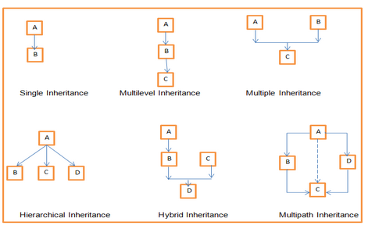
Chapter 18

Slide 22

SINGLE LEVEL INHERITANCE
Single inheritance is defined as the inheritance in which a derived class is inherited from the only one base class.
Where 'A' is the base class, and 'B' is the derived class.
Class B contain properties of Class A based on inheritance visibility mode.
Chapter 18
Notes:
Chapter 2

Slide 23

Multi Level Inheritance
Multilevel inheritance is a process of deriving a class from another derived class.
Here A is superclass or base class from which B is derived and from B class, “C” class is derived.
So class “C” contain propertied of both class A and B based on inheritance visibility mode.
Chapter 18
Notes:
Chapter 2

Slide 24
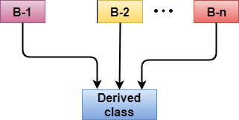
Multiple Inheritance
Multiple inheritance is the process of deriving a new class that inherits the attributes from two or more classes.
Here B-1, B-2….B-n is superclass or base class from which derived class.
So derived class contain properties of all class B-1,B-2… based on inheritance visibility mode.
Chapter 18
Notes:
Chapter 2

Slide 25
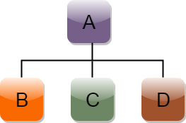
Hierarchical Inheritance
Hierarchical inheritance is defined as the process of deriving more than one class from a base class.
Class B, C and D is inherited from class A so class A is base class or super class of class B, C and D.
Chapter 18
Notes:
Chapter 2

Slide 26
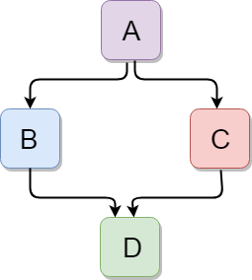
Hybrid Inheritance
Hybrid inheritance is a combination of more than one type of inheritance.
Diagram contain 2 inheritance : Hierarchical inheritance and Multiple Inheritance.
Here class B and C is child class of class A which is possible by Hierarchical Inheritance.
Class D is derived from class B & C using Multiple Inheritance.
Chapter 18
Notes:
Chapter 2

Slide 27
SINGLE LEVEL INHERITANCE
Single inheritance is defined as the inheritance in which a derived class is inherited from the only one base class.
Where 'A' is the base class, and 'B' is the derived class.
Class B contain properties of Class A based on inheritance visibility mode.
Chapter 18
Notes:
Chapter 2

Slide 28
SINGLE LEVEL INHERITANCE
#include <iostream>
class Account
{
float salary;
public:
void getsalary() { cin>>salary;}
void putsalary() { cout<<“Salary:”<<salary;}
};
class Programmer: public Account
{
float bonus;
public:
void getbonus(){cin>>bonus;}
void putbonus(){cout<<“Bonus:”<<bonus;}
};
Chapter 18
Notes:
Chapter 2

Slide 29
SINGLE LEVEL INHERITANCE
int main(void)
{
Programmer p1;
p1.getsalary();
p1.getbonus();
p1.putsalary();
p1.putbonus();
return 0;
}
Chapter 18
Notes:
Chapter 2

Slide 30
Program Explanation
In program, Account is base class and Programmer is child class.
Programmer class derived with public inheritance.
class Programmer : public Account
It means public member of Base class (void getsalary() and void putsalary() ) becomes public member of Programmer class.
So we can call base class public member using object of Programmer class.
P1.getsalary() // Valid
Chapter 18
Notes:
Chapter 2

Slide 31
Program Explanation
If Programmer class derived with private inheritance.
class Programmer : private Account
It means public member of Base class (void getsalary() and void putsalary() ) becomes private member of Programmer class.
So we cannot call base class public member using object of Programmer class.
P1.getsalary() // InValid
In such situation, we have to call it from the child class member function using nested function concept.
Chapter 18
Notes:
Chapter 2

Slide 32
Constructor & Destructor in Single Inheritance.
Base class constructors are called first and the derived class constructors are called next in single inheritance.
Destructor is called in reverse sequence of constructor invocation i.e. The destructor of the derived class is called first and the destructor of the base is called next.
Chapter 18
Notes:
Chapter 2

Slide 33
Int sum(int,int)
Int sum(int,int,int)
Int sum(int,int)
double sum(int,double)
Chapter 18

Slide 34
FUNCITON OVERRIDING
Function overriding is a feature that allows us to have a same function in child class which is already present in the parent class.
If derived class defines same function as defined in its base class, it is known as function overriding in C++.
It is used to achieve runtime polymorphism.
It enables you to provide specific implementation of the function which is already provided by its base class.
It is like creating a new version of an old function, in the child class.
Chapter 18
Notes:
Chapter 2

Slide 35
FUNCITON OVERRIDING REQUIREMENT
Possible only in Inheritance. Require at least 2 class.
Both sub and base class contain same function declaration.
Chapter 18
Notes:
Chapter 2

Slide 36
FUNCITON OVERRIDING
#include <iostream>
class Animal
{
public:
void eat()
{
cout<<"Eating...";
}
};
class Dog: public Animal
{
public:
void eat()
{
cout<<"Eating bread...";
}
};
Chapter 18
Notes:
Chapter 2

Slide 37
FUNCITON OVERRIDING
int main(void)
{
Dog d;
d.eat();
d.eat();
return 0;
}
Output:
Eating bread.
Eating bread.
Chapter 18
Notes:
Chapter 2

Slide 38
Explanation
Here both class contain “eat()” function.
So It is known as function overriding.
It create ambiguity
Compiler always called only derived class function . It cannot called base class eat() function.
To solve this ambiguity we have to use membership label to call base class function like
d.animal::eat()
Chapter 18
Notes:
Chapter 2

Slide 39
Explanation
If you want to call the Overridden function from overriding function then you can do it like this:
parent_class_name::function_name
Chapter 18
Notes:
Chapter 2

Slide 40
Multi Level Inheritance
Multilevel inheritance is a process of deriving a class from another derived class.
Here A is superclass or base class from which B is derived and from B class, “C” class is derived.
So class “C” contain properties of both class A and B based on inheritance visibility mode.
Chapter 18
Notes:
Chapter 2

Slide 41
Multi Level Inheritance
class A // base class
{
...........
};
class B : <acess_specifier> A // derived class
{
...........
} ;
class C : <access_specifier> B // derived from derived class B
{
...........
} ;
Access specifier can be public , private or protected.
Chapter 18
Notes:
Chapter 2

Slide 42
Multi Level Inheritance Example
#include <iostream>
class Animal
{
public:
void eat()
{
cout<<"Eating..."<<endl;
}
};
class Dog: public Animal
{
public:
void bark()
{
cout<<"Barking..."<<endl;
}
};
class BabyDog: public Dog
{
public:
void weep()
{
cout<<"Weeping...";
}
};
Chapter 18
Notes:
Chapter 2

Slide 43
Multi Level Inheritance Example
int main(void)
{
BabyDog d1;
d1.eat();
d1.bark();
d1.weep();
return 0;
}
Output:
Eating...
Barking...
Weeping...
Here first Dog class inherit data from Animal class so Public member of base class becomes public in Dog class.
After that Babydog class inherit data from Dog class so all public member of Dog class ( including Animal class) is becomes public of Babydog class.
Chapter 18
Notes:
Chapter 2

Slide 44
Multi Level Inheritance
Here after execution of following line
class Dog: public Animal
Class Dog is look like as
  class Dog
  {
  public:
  void bark()
  {
  cout<<"Barking..."<<endl;
  }
  void eat() // public function of base class Animal
  {
  cout<<"Eating..."<<endl;
  }
  };
Chapter 18
Notes:
Chapter 2

Slide 45
Multi Level Inheritance
Here after execution of following line
class BabyDog: public Dog
Class BabyDog is look like as
  class Dog
  {
  public:
  void bark()
  {
  cout<<"Barking..."<<endl;
  }
  void eat() // public function of base class Animal
  {
  cout<<"Eating..."<<endl;
  }
  };
Chapter 18
Notes:
Chapter 2

Slide 46
Multi Level Inheritance
class BabyDog
{
public:
void weep()
{
cout<<"Weeping...";
}
void bark() // public function of base class Dog
  {
  cout<<"Barking..."<<endl;
  }
  void eat() // public function of base class Animal
  {
  cout<<"Eating..."<<endl;
  }
  };
Chapter 18
Notes:
Chapter 2

Slide 47
Student
dept
Private:
Int id
Char name
Public:
Void get()
Void put()
Private:
Int did
Char dname
Public:
Void dget()
Void dput()
public
public
Private:
Int mark[5],total,per
Public:
Void mget()
Void mput()
Marksheet
Chapter 18

Slide 48
Student
dept
Private:
Int id
Char name
Public:
Void get()
Void put()
Private:
Int did
Char dname
Public:
Void dget()
Void dput()
Void get()
Void put()
After public inheritance with student
public
Private:
Int mark[5],total,per
Public:
Void mget()
Void mput()
Marksheet
Chapter 18

Slide 49
Marksheet
Private:
Int mark[5],total,per
Public:
Void mget()
Void mput()
Void dget()
Void dput()
Void get()
Void put()
After public inheritance with dept
Marksheet m;
m.mget();
m.mput();
m.dget();
m.dput();
m.get();
m.put();
Chapter 18

Slide 50
Student
dept
Private:
Int id
Char name
Public:
Void get()
Void put()
Private:
Int did
Char dname
Public:
Void dget()
Void dput()
private
public
Private:
Int mark[5],total,per
Public:
Void mget()
Void mput()
Marksheet
Chapter 18

Slide 51
Student
dept
Private:
Int id
Char name
Public:
Void get()
Void put()
Private:
Int did
Char dname
Void get()
Void put()
Public:
Void dget()
Void dput()
After public inheritance with student
public
Private:
Int mark[5],total,per
Public:
Void mget()
Void mput()
Marksheet
Chapter 18

Slide 52
Marksheet
Private:
Int mark[5],total,per
Public:
Void mget()
Void mput()
Void dget()
Void dput()
After public inheritance with dept
Marksheet m;
m.mget();
m.mput();
m.dget();
m.dput();
Chapter 18

Slide 53
Student
dept
Private:
Int id
Char name
Public:
Void get()
Void put()
Private:
Int did
Char dname
Public:
Void dget()
Void dput()
private
Private
Private:
Int mark[5],total,per
Public:
Void mget()
Void mput()
Marksheet
Chapter 18

Slide 54
Student
dept
Private:
Int id
Char name
Public:
Void get()
Void put()
Private:
Int did
Char dname
Void get()
Void put()
Public:
Void dget()
Void dput()
After public inheritance with student
Private
Private:
Int mark[5],total,per
Public:
Void mget()
Void mput()
Marksheet
Chapter 18

Slide 55
Marksheet
Private:
Int mark[5],total,per
Void dget()
Void dput()
Public:
Void mget()
Void mput()
After private inheritance with dept
Void marksheet::mget()
{
dget();
for(i=0;i<5;i++)
cin>>mark[i]
}
Marksheet m;
m.mget();
m.mput();
Void dept::dget()
{
get();
}
Chapter 18

Slide 56
Explanation
In this situation , to call or access the private data of student class , we have to call get() and put().
But get() and Put() are private member of dept class.
So we cant call directly using marksheet class object.
So to call or input value for sid and sname we call get() from dget().
void dept::dget()
{
get(); // call student class function.
other code
}
Chapter 18
Notes:
Chapter 2

Slide 57
Multiple Inheritance
Multiple inheritance is the process of deriving a new class that inherits the attributes from two or more classes.
Here B-1, B-2….B-n is superclass or base class from which derived class.
So derived class contain properties of all class B-1,B-2… based on inheritance visibility mode.
Chapter 18
Notes:
Chapter 2

Slide 58
Multi Level Inheritance
class A
{
..........
};
class B
{
...........
} ;
class C : acess_specifier A,access_specifier B
// derived class from A and B
{
...........
} ;
Chapter 18
Access specifier can be public , private or protected.
Notes:
Chapter 2

Slide 59
Multiple Inheritance Example
#include<iostream.h>
class A
{
public:
int x;
void getx()
{
cout << "enter value of x: "; cin >> x;
}
};
class B
{
public:
int y;
void gety()
{
cout << "enter value of y: "; cin >> y;
}
};
Chapter 18
Notes:
Chapter 2

Slide 60
Multiple Inheritance Example
class C : public B , public A //C is derived from class A and class B
{
public:
void sum()
{
cout << "Sum = " << x + y;
}
};
Chapter 18
Notes:
Chapter 2

Slide 61
Multiple Inheritance Example
int main()
{
C obj1; //object of derived class C
obj1.getx();
obj1.gety();
obj1.sum();
return 0;
}
In above program multiple inheritance implement by following line of code.
class C : public B , public A
Here class c contain members of both class A and class B.
Chapter 18
Notes:
Chapter 2

Slide 62
Multiple Inheritance Example
After execution of following line, class c is look like as
class C : public B , public A
class C:
{
public:
void sum() { cout << "Sum = " << x + y; }
void getx() { cout << "enter value of x: "; cin >> x; }
void getx() { cout << "enter value of x: "; cin >> x; }
};
Chapter 18
Notes:
Chapter 2

Slide 63
Ambiguity in Multiple Inheritance
The most obvious problem with multiple inheritance occurs during function overriding.
Suppose, two base classes have a same function which is not overridden in derived class.
If you try to call the function using the object of the derived class, compiler shows error. It's because compiler doesn't know which function to call. For example,
Chapter 18
Notes:
Chapter 2

Slide 64
Ambiguity in Multiple Inheritance
class base1
{
public:
void get( )
{ .... ... .... }
};
class base2
{
void get( )
{ .... ... .... }
};
class derived : public base1, public base2
{
};
Chapter 18
Notes:
Chapter 2

Slide 65
Ambiguity in Multiple Inheritance
int main()
{
derived obj;
obj.someFunction() // Error!
}
Here derived class contain two copy of get() from base1 and base2. So During function call it create ambiguity for compiler.
Chapter 18
Notes:
Chapter 2

Slide 66
Ambiguity in Multiple Inheritance
This problem can be solved using scope resolution function to specify which function to class either base1 or base2
int main()
{
obj.base1::someFunction( ); // Function of base1 class is called
obj.base2::someFunction(); // Function of base2 class is called.
}
Chapter 18
Notes:
Chapter 2

Slide 67
Hybrid Inheritance
Hybrid inheritance is a combination of more than one type of inheritance.
Diagram contain 2 inheritance : Hierarchical inheritance and Multiple Inheritance.
Here class B and C is child class of class A which is possible by Hierarchical Inheritance.
Class D is derived from class B & C using Multiple Inheritance.
Chapter 18
Notes:
Chapter 2

Slide 68
Hybrid Inheritance Syntax
class base_class {
... .. ...
};
class first_derived_class: <Access Specifier> base_class {
... .. ...
};
class second_derived_class: <Access Specifier> base_class {
... .. ...
};
class third_derived_class: <Access Specifier> base_class {
... .. ...
};
Chapter 18
Access specifier can be public , private or protected.
Notes:
Chapter 2

Slide 69
Hybrid Inheritance Example
class A {
... .. ...
};
class B: public A {
... .. ...
};
class C: public A {
... .. ...
};
class D: public B,public C {
... .. ...
};
Chapter 18
Access specifier can be public , private or protected.
Notes:
Chapter 2

Slide 70
Hybrid Inheritance
Diagram contain 2 inheritance : Hierarchical inheritance and Multiple Inheritance.
Here class B and C is child class of class A which is publicly derived from class A.
Class D is derived publicly from class B & C using Multiple Inheritance.
So class D contain member of all class A, B and C.
Chapter 18
Notes:
Chapter 2

Slide 71
Hybrid Inheritance
#include<iostream>
class Person
{
int id;
char name[200];
public:
void accept_person_details()
{
cinn>>id>>name;
}
void display_person_details()
{
cout<<"\n Id : "<<id<<"\n Name: "<<name;
}
};
Chapter 18
Notes:
Chapter 2

Slide 72
Hybrid Inheritance
class Teaching : public Person
{
char subject_name[100];
char teacher_name[200];
public:
void accept_teacher_details()
{
accept_person_details();
cout<<"\n Enter Subject Name : ";
cin>>subject_name;
cout<<"\n Enter Teacher Name : ";
cin>>teacher_name;
}
Chapter 18
Notes:
Chapter 2

Slide 73
Hybrid Inheritance
void display_teacher_details()
{
display_person_details();
cout<<"\n Subject Name : "<<subject_name;
cout<<"\n Teacher Name : "<<teacher_name;
}
};
class NonTeaching : public Person
{
char dept_name[200];
public:
void accept_nonteaching_details()
{
cout<<"\n Enter Department Name : ";
cin>>dept_name;
}
Chapter 18
Notes:
Chapter 2

Slide 74
Hybrid Inheritance
void display_nonteaching_details()
{
cout<<"\n Department Name : "<<dept_name;
}
};
class Instructor : public NonTeaching, public Teaching
{
public:
void accept_instructor_details()
{
accept_teacher_details();
accept_nonteaching_details();
}
Chapter 18
Notes:
Chapter 2

Slide 75
Hybrid Inheritance
void display_instructor_details()
{
display_teacher_details();
display_nonteaching_details();
}
};
int main()
{
Instructor inst[3];
int cnt, i;
for(i=0; i<cnt; i++)
{
inst[i].accept_instructor_details();
}
Chapter 18
Notes:
Chapter 2

Slide 76
Hybrid Inheritance
for(i=0; i<cnt; i++)
{
inst[i].display_instructor_details();
}
return 0;
}
Chapter 18
Notes:
Chapter 2

Slide 77
Hybrid Inheritance
Ambiguity in Hybrid Inheritance
OR
Diamond Problem in Hybrid Inheritance
OR
What is Virtual base class? Why we require it? Explain with example
Chapter 18
Notes:
Chapter 2

Slide 78
Continue…
Diamond Problem or Ambiguity: The diamond problem occurs when two super classes of a class have a common base class.
For example, in the following diagram, we use Hierarchical inheritance and multilevel inheritance.
“A” class is inherited by class “B” and “C” is example of hierarchical inheritance .
A
B
C
D
Chapter 18
Notes:
Chapter 2

Slide 79
Continue…
“D” class is derived from “B” and “C” class which is the example of multiple inheritance.
As we can see from the figure that data members of class A are inherited twice to class D. One through class B and second through class C.
Chapter 18
Notes:
Chapter 2

Slide 80
Continue…
When any data / function member of class A is accessed by an object of class D, ambiguity arises as to which data/function member would be called? One inherited through B or the other inherited through C. This confuses compiler and it displays error.
Chapter 18
Notes:
Chapter 2

Slide 81
Continue…
#include <iostream>
class A
{
public:
void show()
{
cout << "Hello form A \n";
}
};
class B : public A { };
class C : public A { };
class D : public B, public C { };
int main()
{
D object;
object.show();
}
Output:
Compile error: Request for member 'show' is ambiguous
Chapter 18
Notes:
Chapter 2

Slide 82
Solution of Ambiguity / Virtual Base Class
To resolve this ambiguity when class A is inherited in both class B and class C, it is declared as virtual base class by placing a keyword virtual as :
  class B : virtual public A
  {
  };
  class C : public virtual A
  {xx
  };
A
B
C
D
Chapter 18
Notes:
Chapter 2

Slide 83
Solution of Ambiguity / Virtual Base Class
virtual can be written before or after the visibility mode.
Now only one copy of data/function member will be copied to class C and class B and class A becomes the virtual base class.
Virtual base classes offer a way to save space and avoid ambiguities in class hierarchies that use multiple inheritances.
When a base class is specified as a virtual base, it can act as an indirect base more than once without duplication of its data members.
A single copy of its data members is shared by all the base classes that use virtual base.
Chapter 18
Notes:
Chapter 2

Slide 84
Continue…
#include <iostream>
class A
{
public:
void show()
{
cout << "Hello Everyone \n";
}
};
class B : virtual public A { };
class C : public virtual A { };
class D : public B, public C { };
int main()
{
D object;
object.show();
}
Output:
Hello Everyone
Chapter 18
Notes:
Chapter 2

Slide 85
Solution of Ambiguity / Virtual Base Class
Here only one copy of the show( ) is inherited to class D because Class A is virtually inherited in class B and class C. Now class B and class C becomes virtual base class and no duplication of data member a is done.
Chapter 18
Notes:
Chapter 2

Slide 86
Protected Modifier
Protected, is the last access specifier, and it is similar to private, it makes class member inaccessible outside the class. But they can be accessed by any subclass of that class.
If class A is inherited by class B, then class B is subclass of class A. So class B can access protected member of class A.
Chapter 18
Notes:
Chapter 2

Slide 87
Protected Modifier in Inheritance
#include <bits/stdc++.h>
using namespace std;
// base class
class Parent
{
// protected data members
protected:
int id_protected;
};
// sub class or derived class
class Child : public Parent
{
public:
void setId(int id)
{
// Child class is able to access the inherited
// protected data members of base class
id_protected = id;
}
void displayId()
{
cout << "id_protected is: " << id_protected << endl;
}
};
// main function
int main() {
Child obj1;
// member function of the derived class can
// access the protected data members of the base class
obj1.setId(81);
obj1.displayId();
return 0;
}
class ProtectedAccess
{
// protected access modifier
protected:
int x; // Data Member Declaration
void display(); // Member Function decaration
}
Chapter 18
Notes:
Chapter 2

Slide 88
Nested Class OR Containership OR Aggregation
Containership is also referred as nesting class OR aggregation OR Containment.
In Nesting class OR containership, One class has an object of another class as its member.
In Nesting, the class that contain an object has access only to the public members of that class. The private and protected members of the contained class are not accessible to the enclosing class.
However in inheritance, the derived class can access the protected member of the base class also.
It is often referred to as a “has-a” relationship because the objects of the composite class have objects of the composed class as members.
Chapter 18
Notes:
Chapter 2

Slide 89
Nested Class OR Containership OR Aggregation
class <outer class>
{
class <inner calss>
{
……
} <object>;
};
class <inner calss>
{
……
};
class <outer class>
{
object of inner class;
…..
};
Chapter 18
Notes:
Chapter 2

Slide 90
Example : Nested Class
class B
{
public:
A x; // object of class “a”
void displayXY()
{
x.getx();
x.gety();
}
};
int main()
{
B y;
y.displayXY();
getch();
return(0);
}
class A
{
protected:
int y;
void gety()
{
cout<<"Y:"<<y;
}
public:
int x;
A() {x=10,y=11;}
void getx()
{
cout<<"A:"<<x<<"\n";
}
};
Chapter 18
Notes:
Chapter 2

Slide 91
Nested Class OR Containership OR Aggregation
Here the object of class “b” will contain the object of class “a”. This kind of relationship is called “Containership” OR “Nested Class”.
Public member of class “a” is accessible by object of class “b”. Here getX() is accessible and it print the value of public member “x”
It cannot access the protected member of class “a” here getY() generated error.
Chapter 18
Notes:
Chapter 2

Slide 92
When to use Containership & Inheritance?
Containership
When features of existing class are wanted inside your new class, but, not its interface
Example: Computer system has a hard disk
Car has an Engine, chassis, steering wheels.
Inheritance
When you want to force the new type to be the same type as the base class.
Example: Computer system is an electronic device
Car is a vehicle
Chapter 18
Notes:
Chapter 2

Slide 93
Containership Example
// Container class
class second {
// creating object of first
first f;
public:
// constructor
second()
{
// calling function of first class
f.showf();
}
};
class first
{
public:
void showf()
{
cout << "Hello from first class\n";
}
};
Chapter 18
Notes:
Chapter 2

Slide 94
Containership Example
Explanation:
In the class second we have an object of class first.
This is another type of inheritance we are witnessing.
This type of inheritance is known as “has_a” relationship as we say that class second has an object of first class first as its member.
From the object f we call the function of class first.
int main()
{
// creating object of second
second s;
}
Output:
Hello from first class
Chapter 18
Notes:
Chapter 2

Slide 95
Containership Example
// Container class
class second {
// creating object of first
first f;
public:
// constructor
second()
{
cout << "Hello from second class\n";
}
};
class first
{
public:
void showf()
{
cout << "Hello from first class\n";
}
};
Chapter 18
Notes:
Chapter 2

Slide 96
Containership Example
Explanation:
In this program we have not inherited class first into class second but as we are having an object of class first as a member of class second.
So when default constructor of class second is called, due to presence of object f of first class in second, default constructor of class first is called first and then default constructor of class second is called .
int main()
{
// creating object of second
second s;
}
Output:
Hello from first class
Hello from second class.
Chapter 18
Notes:
Chapter 2

Slide 97
Inheritance VS Containership
Chapter 18

Slide 98
Nested Class VS Inheritance
Inheritance | Containership
Inheritance is the ability for a class to inherit properties and behaviour from a parent class by extending it. | Containership is the ability of a class to contain objects of different classes as member data.
If a class is extended, it inherits all the public and protected properties and those properties may be overridden by the subclass. | If a class is contained in another, the container does not get the ability to change or add properties to the contained.
Protected members of class “a” can be accessed by the member function of derived class “b”. | Protected members of class “a” cannot be accessed by the member function of class “b”.
Support the concepts of reusability. | Does not support the concepts of reusability.
Represent “is-a” relationship. | Represent “has-a” relationship.
Chapter 18
Notes:
Chapter 2

Slide 99
Operator Overloading
Operator overloading is a compile-time polymorphism.
In which the operator is overloaded to provide the special meaning to the user-defined data type.
Operator overloading is used to overload or redefines most of the operators available in C++.
It is used to perform the operation on the user-defined data type.
For example, C++ provides the ability to add the variables of the user-defined data type that is applied to the built-in data types.
Chapter 18
Notes:
Chapter 2

